Slide 1
Know Your News
Introduction to News Literacy

Slide 2
News Literacy:
The ability to use critical thinking skills to judge the reliability and credibility of news reports and information sources.
www.whynewsmatters.org

Slide 3
What is news?
Standard, objective, fact-based reporting on a current matter of public concern.

Slide 4
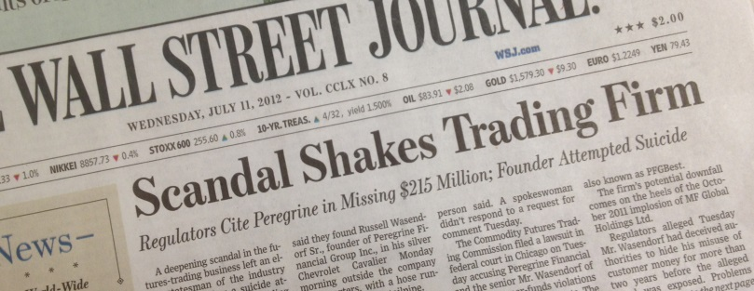
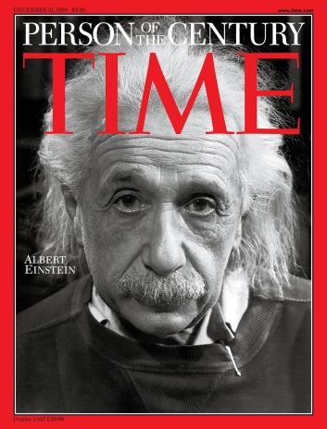

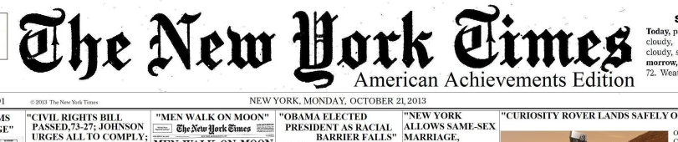



Where do we get our news?
Newspapers and magazines
Websites, blogs, apps on mobile devices
Radio, podcasts, television
Social media

Slide 5
Questions to ask yourself when reading or listening to a piece of information:
What type of content is this?
  Is it news, an opinion piece, raw information, an interview, an advertisement, propaganda or entertainment?
  Who is the author & producer?
Adapted from:
Blur: How to Know What to Believe in the Age of Information Overload by Tom Rosenstiel and Bill Kovach

Slide 6
Who are the sources cited, and are they credible?
If people are quoted, who are they? A political official? An expert in a particular field? An eye-witness on the scene?
If research or reports are referenced, what organizations produced and funded such research? What background is offered?
If you are left unsure, then investigate further.
Adapted from:
Blur: How to Know What to Believe in the Age of Information Overload by Tom Rosenstiel and Bill Kovach

Slide 7
Is the evidence clear or transparent?
Is it clear how the source knows the information he/she is providing? Did the reporter or author check multiple sources?
Does the article make sense? Is there information missing or still developing? If so, has that been acknowledged by the author?
Adapted from:
Blur: How to Know What to Believe in the Age of Information Overload by Tom Rosenstiel and Bill Kovach

Slide 8
News in a Digital Age?
The Blurred Lines Between Fact & Fiction in Online News Outlets.
Fictional news stories can quickly become trending topics that are mistaken for actual news.
This has occurred when online news organizations, including Gawker, BuzzFeed, The Huffington Post, and Mashable publish embellished or fictionalized accounts alongside serious & credible news content.
Editors at these sites acknowledge frankly that there are trade-offs in balancing authenticity with the need to act quickly in a hyper-connected age that doesn’t allow much time for fact checking.
Notes:
Source: http://www.nytimes.com/2013/12/10/business/media/if-a-story-is-viral-truth-may-be-taking-a-beating.html?pagewanted=all&_r=0

Slide 9
News in a Digital Age
What to believe, Tweet, post, like, and share?
Stories shared online or through phones and tablets can be seen and shared instantly.
Even if someone you know or a celebrity shares a story, it might not be factual. If you are unsure, look into the topic, click on the link & review the original source before forming ad opinion on the topic or sharing with others.

