Slide 1
The Water Issue in the United States
Applying News Literacy Principles
in the Science Classroom

Slide 2
News Literacy
Let’s discuss:
Name a recent instance in which you got information from a newspaper, TV news or an Internet news site that you later learned was incorrect.
Is everything that you see or read in the news always factual?

Slide 3
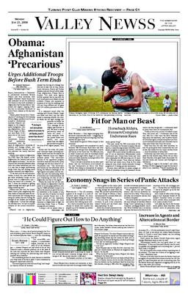
Source: The News Literacy Project
A Consumer's Guide to Sourcing in News Reports
Sources Video

Slide 4
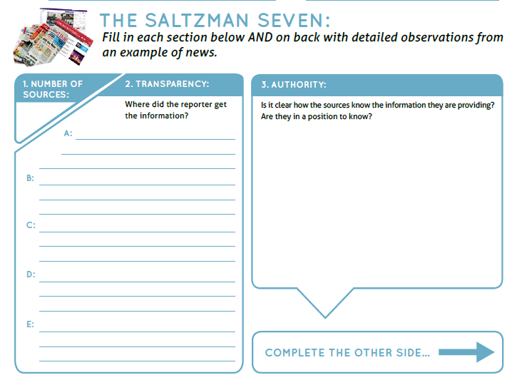
Use this while evaluating your articles .

Slide 5
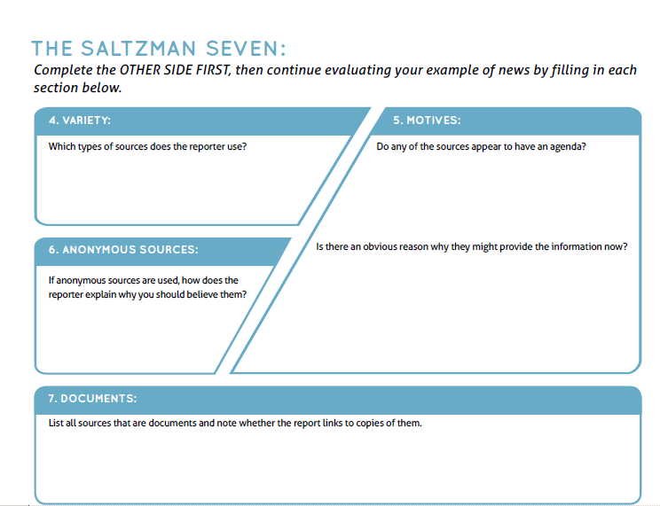

Slide 6
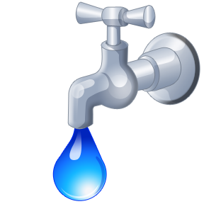
In summary :
Let’s Discuss the Water Supply
Where do we get our water?
Is our water limited?
Do we have enough water for all of our needs?
Do we pay for our water?
Consider these same questions for different regions of the United States.

Slide 7
Writing Assignment
Your assignment is to write an essay discussing the severity of the water issue in the United States.
You are to refer to the articles that we discussed in class and the notes that you took. You are encouraged to do research for more current articles about this topic that can support your essay.

