Slide 1
Counting the Hungry
First, read the Food Insecurity Survey.
Then, write out your prediction on a sticky note for the number of children in NYC who would answer yes to the Food Insecurity Survey.

Slide 2
USDA defines “food insecure” as the condition under which:
“the food intake of one or more household members was reduced and their eating patterns were disrupted at times during the year because the household lacked money and other resources for food.”

Slide 3
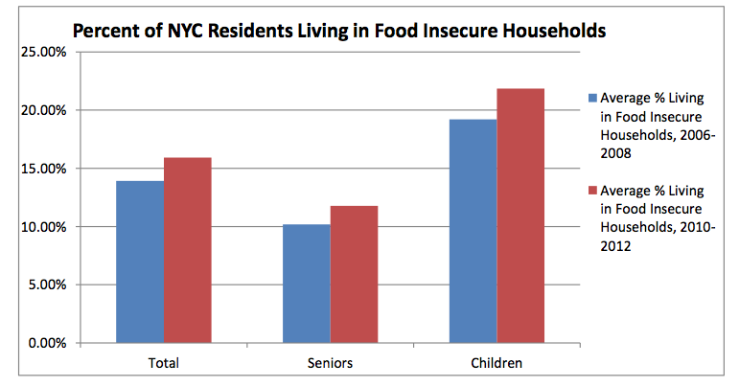

Slide 4
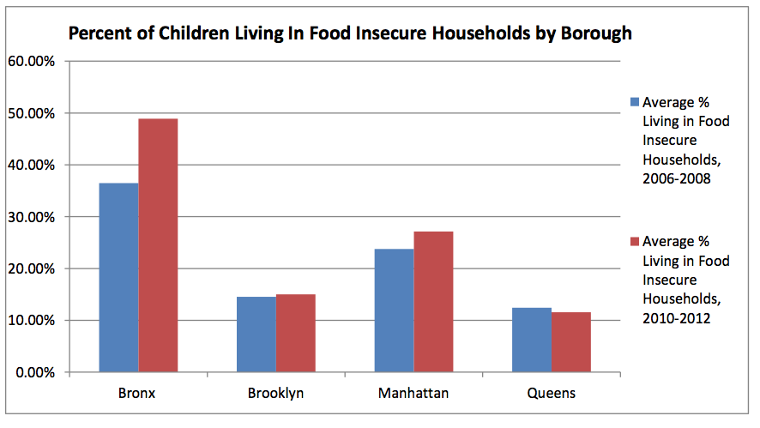
Notes:
NYC hunger, page 4

Slide 5
WHAT DO YOU
NOTICE?

Slide 6

WORLD HUNGER
ESTIMATES

Slide 7
WORLD HUNGER ESTIMATES
1990
1990
1990
1990
1990
1990

Slide 8
1.015
Billion
2014
WORLD HUNGER ESTIMATES
995
Million
2013
980
Million
2012
833
Million
2011
823
Million
2004
786
Million
1992
1990
1990
1990
1990
1990
1990

Slide 9
1.015
Billion
2014
WORLD HUNGER ESTIMATES
995
Million
2013
980
Million
2012
1990 Estimates
Other Estimates
833
Million
2011
823
Million
2004
786
Million
1992
852
Million
in 2012
839
Million
in 2011
815
Million
in 2004
826
Million
in 2013
790
Million
in 2014
1990
1990
1990
1990
1990
1990

Slide 10
Do Now
Answer the questions on the worksheet with your partner.
If you see a calculator icon, that means we suggest you use a calculator to solve the question.
If there is no calculator icon, then we encourage you to find a way to reasonably estimate the problem.

