Slide 1
Using the Regression Line Model to Make Predictions
Scatter Plot Review

Slide 2
Using the Regression Line Model to Make Predictions
It’s the responsibility of the news medium to report on important decisions made by newsmakers. Examples include new traffic laws based on the number of accidents, immigration reform based on the number of people emigrating to the U.S., and gas prices based on the supply and demand of oil. These decisions make headlines because of the impact they have on our lives.
Sometimes politicians, lawmakers, and other leaders make their decisions based on predictions from data they receive. They use mathematical models to make their predictions, which in turn form their decisions. The line of best fit, or regression line, is one of those models.
The data that we will be looking at is called bivariate data. A bivariate data set consists of observations on two variables. For example, the annual average unemployment rate and the average annual consumer confidence index from 2006 to 2014 are shown in the table below.

Slide 3
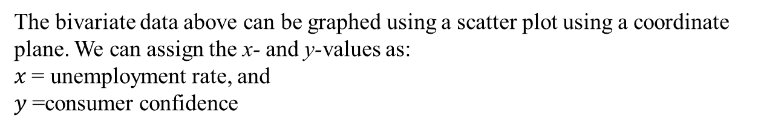
Year | Unemployment Rate (%) | Consumer Confidence
2006 | 4.6 | 106
2007 | 4.6 | 103
2008 | 5.8 | 58
2009 | 9.3 | 45
2010 | 9.6 | 54
2011 | 8.9 | 58
2012 | 8.1 | 67
2013 | 5.8 | 73
2014 (est.) | 6.2
The bivariate data above can be graphed using a scatter plot using a coordinate plane. We can assign the x- and y-values as:
$x$ = unemployment rate, and
$y$ =consumer confidence

Slide 4
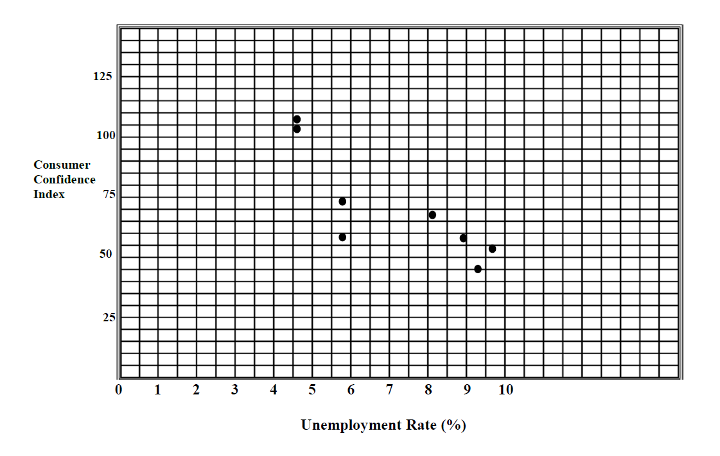

Slide 5
Using the Regression Line Model to Make Predictions
Remember, when two sets of data have a connection that can be described verbally or mathematically, there is a relationship. A correlation describes how strong the relationship is between the two variables. A positive correlation indicates that both values are increasing together. A negative correlation occurs when one value decreases as the other increases. In our example, consumer confidence decreases as the unemployment rate increases.

