Slide 1
Analyzing Statistics In the News
How Margin of Error, deviation from the mean, and standard deviation can measure our confidence in the data

Slide 2
Looking at Statistics In the News
Objectives
Students will be able to calculate the standard deviation of a set of data.
Students will be able to explain the reliability of a set of data using measures such as margin of error and standard deviation.

Slide 3
Standards of Mathematical Practice
MP 1. Make sense of problems and persevere in solving them.
MP 2. Reason abstractly and quantitatively.
MP 3. Construct viable arguments and critique the reasoning of others.
MP 6. Attend to precision.

Slide 4
Common Core Standards
S-ID.2 Use statistics appropriate to the shape of the data distribution to compare center (median, mean) and spread (interquartile range, standard deviation) of two or more different data sets.
S-IC.6 Evaluate reports based on data.

Slide 5
Looking at Statistics In the News
Do Now: When data is displayed in graphs and charts, what are some ways that we can tell whether the data is accurate or misleading?
Additional Do Now: You read a recent news article reporting on the results of a poll that states 43% of voters would vote for Hillary Clinton if she ran for president. The article explains that the margin of error of the poll is ±3.1%. How does the margin of error affect the results of the poll?

Slide 6
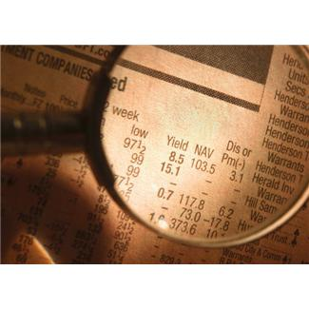
Looking at Statistics In the News
As news consumers, we are often presented with reports of statistics that are very newsworthy. The latest election polls, the change in financial markets, studies on the effectiveness of new medications, and new scientific discoveries are all examples of news stories that can include sets of data.

Slide 7
Looking at Statistics In the News
Reporters and editors are responsible for analyzing data and presenting it to the public so that it’s easy to read and understand. Sometimes news organizations are handed hundreds of pages of important data but only have a limited amount of space (in a newspaper or magazine) or time (for radio and TV) to present the findings!

Slide 8
Looking at Statistics In the News
What are some ways to “summarize” a set of data?
One way to summarize a set of data is to find the central tendencies of its distribution. The mean, median, and mode are all measures of central tendency. For example, it is easier to write the mean, or average, of a set of data, then it is to write each data value. The median, or “middle number,” is another example of a measure of central tendency that helps characterize a set of data.

Slide 9
Looking at Statistics In the News
We are constantly presented with different representations of statistics in the news, in advertisements, on the internet, etc. It’s crucial as a modern society to be able to interpret the statistics that we see and hear in the media. There are several different measures that we can use to help us better understand the statistics that are presented to us.

