Slide 1
Understanding the Distribution of a Set of Data
Using Standard Deviation to Analyze Reports

Slide 2
Understanding the Distribution of a Set of Data
The mean is a measure to help us understand the center of distribution of a set of data. However, the mean only shows us part of the story behind the statistics. We can also tell how far the individual data values are from the mean of the data set using other statistical measures. (We say that a data value that is not the mean, “deviates” from the mean.)
Examples of these measures are the margin of error, deviation from the mean, and the standard deviation.

Slide 3
Understanding the Distribution of a
Set of Data
The margin of error is mainly used in surveys. The margin of error represents the amount of random sampling error in a survey’s results.
In other words, a survey only questions a sample of people, not the whole population. The fewer number of people in the sample, the greater the margin of error.
When reading the results of a survey in the media, it is important for the consumer to know that the larger the margin of error, the less confidence one should have in the survey’s results.

Slide 4
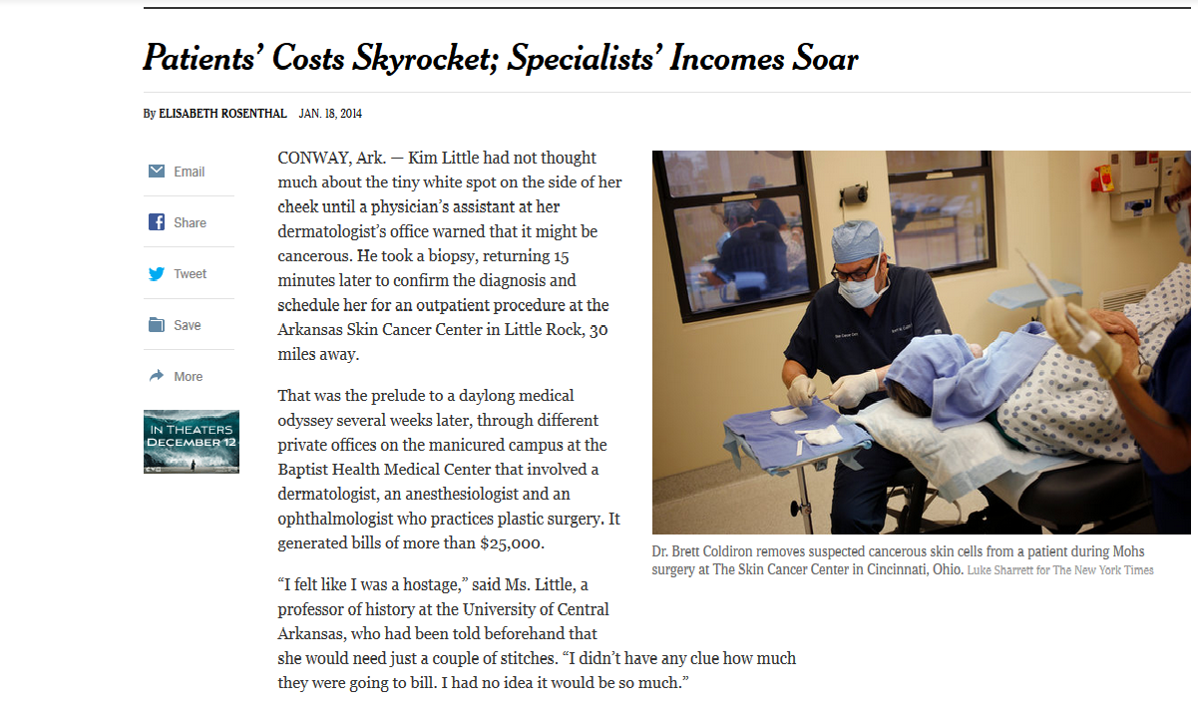
Exercise 1:
From 2013-2014, The New York Times published a series of articles entitled, “Paying Till It Hurts,” on the costs of health care.
In one of the articles, The Times and CBS News conducted a random survey of 1,006 adults. In December 2014, The Times published the article “How the High Cost of Medical Care is Affecting Americans” based on results from the survey. The margin of error was reported as
“4 percentage points in either direction.”

Slide 5
Exercise 1: (continued)
1) What is another way to write the margin of error?
2) The poll asked adults, “Is the amount of time you spend dealing with insurance paperwork and health care bills a major problem for you and your family, a minor problem, or not a problem at all?”
If 16% of adults surveyed answered that it was a “major problem,” what is the range for the entire population of U.S. adults that would give the same answer?
±4%
12% to 20%

Slide 6
Understanding the Distribution of a
Set of Data
The deviation from the mean is how far one of the data points differs from the mean.
If the mean is represented by ̅x and the data value is represented by x, then the deviation from the mean is x – x̅.
For example, the mean for a set of values is 76. If one of the data values is 84, then the deviation from the mean is
84 – 76 = 8.

Slide 7
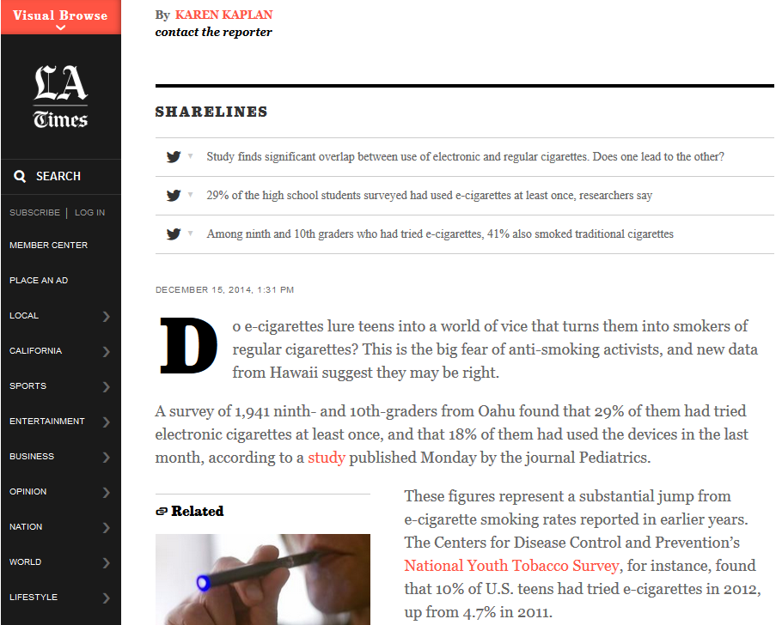
Exercise 2:
A December 2014 article in the Los Angeles Times reported the results from an American Academy of Pediatrics study that surveyed 1,941 ninth- and tenth-grade students in Hawaii on their cigarette and e-cigarette use.
The mean age of the students surveyed was reported as 14.6 years.
If the ages of five students are 15.1 years, 14.8 years, 13.7 years, 14.2 years, and 14.6 years, what are their deviations from the mean?
0.5, 0.2, –0.9, –0.4, and 0

Slide 8
Understanding the Distribution of a
Set of Data
The standard deviation (represented by the Greek letter sigma, σ) is a measure that tells us how spread out the entire set of data points are from the mean of the same data.
For example, in a set of data values that measures the heights of a sample of teenage girls, the mean is listed at 62 inches. The standard deviation of the data set will tell us if the heights of the girls sampled in the survey are clustered close the mean, or dispersed farther from the mean.

Slide 9
Understanding the Distribution of a
Set of Data
Deviation from the mean tells us how far one data point is from the mean whereas standard deviation tells us how far spread apart the entire set of data points are from the mean.
NOTE: Standard deviation is always a positive number. A low standard deviation indicates that the data values are very close to the mean. A high standard deviation tells us that the data values are spread out over a large range of values. A standard deviation of 0 indicates that all data points are equal to the mean.

Slide 10
Understanding the Distribution of a
Set of Data
Standard deviation can tell us more about the statistics that we see in the media.
In financial news stories, standard deviation can tell us how volatile the markets are (or the volatility of the prices of individual investments). (Furthermore, the higher the standard deviation, the more risk is associated with investing.)
In opinion polls, standard deviation can tell us if there will be a large or small margin of error. (The margin of error is determined by calculating the standard deviation in the results if the same poll were to be conducted multiple times.)
In news stories about new medications or results from experiments, standard deviation can give more insight into the effectiveness of the trials.

Slide 11
Understanding the Distribution of a
Set of Data
Example:
Let’s look at the example of the heights of a sample of teenage girls:
The first five girls sampled measure 54 in., 58 in., 65 in., 66 in., 67 in.
The second group measures 61 in., 61 in., 62 in., 62 in., 64 in.
A third group measures 48 in., 59 in., 66 in., 67 in., 70 in.
The mean of the first group of girls is 62 in.
The mean of the second group is also 62 in.
The mean of the third group is 62 in. as well.
However, the standard deviations of the groups are 5.7, 1.2, and 8.8. Notice how the data points in the second group are close to the mean of 62 inches which results in a low standard deviation of 1.2. However, the data points in the first group are farther from the mean and the values in the third group are even more spread out from the mean, thus the higher standard deviations.

Slide 12
Understanding the Distribution of a
Set of Data
To find the standard deviation of a set of data, use the formula:
where n = the number of data values
In other words, the standard deviation is the sum of the deviations from the mean for each data point squared, divided by the number of data points.

Slide 13
Example:
A survey conducted by the Organisation for Economic Co-operation and Development (OECD) polled 15-year-old students around the world on the number of hours they spend per week completing their homework. The results, published in The Huffington Post in December 2014, showed that U.S. students spent a mean of 6.0 hours per week completing their homework.
You conduct a poll of six local 15-year-olds on the number of hours they spend during the week completing their homework. Their answers are shown below:
3.5 hours, 10.25 hours, 6.33 hours, 4.25 hours, 7.0 hours, 8.75 hours
What is the standard deviation of your survey? (Use the mean of your data.)

Slide 14
Example (continued):
The mean for the six responses is 6.68. Now use the formula:

