Slide 1
Using Measures of Data Variation to Evaluate the Credibility of Statistics in the News
Looking at Normal Distribution and Its Familiar Curve

Slide 2
Using Measures of Data Variation to Judge the Credibility of Statistics in the News
Just as you can use measures like the margin of error and standard deviation to gauge your confidence in the data that you’re reading, you can also use these metrics to measure your confidence in the articles or stories where the statistics are reported.
Furthermore, the news media often reports on the decisions and predictions of people who are interpreting the data. These newsmakers can include politicians and lawmakers, scientists, city planners, environmentalists, community leaders, etc.

Slide 3
Using Measures of Data Variation to Judge the Credibility of Statistics in the News
Not only do the standard deviation and margin of error show how much variation lies in the data, but they also help measure the amount of confidence that the reader has in the conclusions that are drawn by the data.
To understand how this occurs, we can take a look at the shape of a normal data distribution.

Slide 4
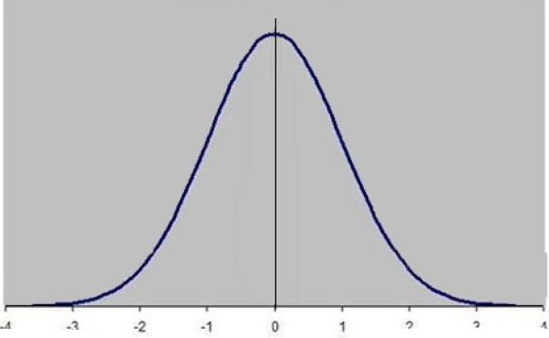
Using Measures of Data Variation to Judge the Credibility of Statistics in the News
A normal distribution of data occurs when the number of data points increases as you approach the mean (and therefore decreases the further from the mean.) If you were to plot the individual data points of a normal distribution on a graph, the figure of a bell-shaped curve would form.
The bell curve, shown below, is symmetrical about the mean. The most frequent values are clustered around the mean, and data points with very large deviations from the mean are extremely rare and occur at the two tail ends of the curve.

Slide 5
Using Measures of Data Variation to Judge the Credibility of Statistics in the News
In a normal distribution, the probability that a random variable will appear is greater the closer you get to the mean. The probability that a random data point will appear approaches zero as you approach either tail of the curve.
Normal distributions appear in many real-world events, from class test scores, to the heights of a population, to economics, to production, and many other situations.

Slide 6
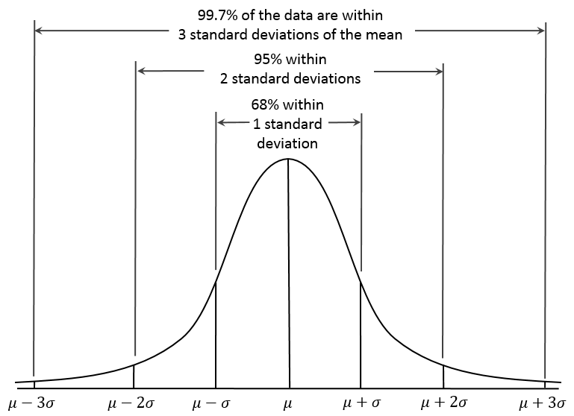
Using Measures of Data Variation to Judge the Credibility of Statistics in the News
In a normal distribution, 68.27% of all data values lie within one standard deviation, 95.45% lie within two standard deviations, and 99.73% lie within three standard deviations.
WikiMedia Commons

Slide 7
Using Measures of Data Variation to Judge the Credibility of Statistics in the News
In most surveys and opinion polls reported in the news media, it is the standard for the results to be two standard deviations from the mean. This is referred to as “a 95% confidence level.”
The more data values that lie outside of two standard deviations, then the more we should question the significance of the data.
In other words, if a study or survey contains data values that are several standard deviations away from the center (or conclusion), then this is evidence that some of the data is not consistent with the overall result or the conclusions drawn by the source.

Slide 8
Using Measures of Data Variation to Judge the Credibility of Statistics in the News
Conclusion
Tables, charts, and graphs presenting statistical data are meaningful ways to tell a news story. Oftentimes, these statistics shape the decisions of both the newsmaker and the news consumer.
When a large amount of data is presented, it is often helpful to summarize the data using measures of center, such as the mean, median, and mode. However, these metrics only tell part of the story.
We can also measure our confidence in the reports by looking at measures of variability – margin of error, deviation from the mean, and standard deviation. These tools help us question the reliability, or significance, of the data from voter surveys, opinion polls, financial news, medical studies, etc. Measures of variability give individuals a better understanding of the information they receive from the news.

Slide 9
Using Measures of Data Variation to Judge the Credibility of Statistics in the News
Principles of News Literacy
3. When the process of gathering and reporting is transparent, news and information are more meaningful, trusted and credible.
Journalists must present information free of bias and agendas. They should clearly identify issues or limitations on that information, including reporting that the information might be incomplete or from questionable sources. Journalistic independence is essential to this process.
Readers and viewers must understand a source’s agendas, motivations and backgrounds so they can make full use of that information, assessing what is true. They need to insist on independent journalists, professionals free of outside obligation and limitation, so they can trust the information they receive. They need to hold media accountable for the quality of information delivered. If members of the public are news sources, they must identify their biases and be transparent in their actions.

Slide 10
Using Measures of Data Variation to Judge the Credibility of Statistics in the News
Principles of News Literacy
4. Effective communication of news and information requires synthesis of multiple sources into meaningful context and comprehension of its impact
Journalists must make sense of information, using the most credible and reliable resources, so audiences can make meaningful use of it, in context, with a minimum need for clarification. In short, journalists must get it right. And it must be presented in a relevant, engaging manner without sensationalism, speculation and bias.
Citizens must take responsibility to make every effort to understand information received, including asking questions and pursuing their own versions of it. They must demand credible and reliable information sources, not infotainment based on information that is not right. And they must be taught the importance of seeking information of consequence.

Slide 11
Using Measures of Data Variation to Judge the Credibility of Statistics in the News
Principles of News Literacy
5. Information requires verification to be effective
Journalists must find the best resources and substantiate what they say. They should present information in coherent ways as well as keep it clear, meaningful and relevant. The purpose of news is not diversion but the sharing of usable and reliable information in an engaging and relevant way. Journalists must question sources without advocacy or disengagement. Journalists’ roles can be called “engaged independence.”
Individuals must expect that the information they receive is accurate, thorough and reliably sourced and that the media delivering this information is responsible and credible. Communities must not accept information without critical thought and analysis, including comparison and evaluation. In evaluating such information, they should be involved, skeptical and challenging, in what they act on.

