Slide 1
Using the Regression Line to Make Predictions
The Line of Best Fit or Regression Line

Slide 2
Using the Regression Line to Make Predictions
The example from the scatter plot uses two economic indicators that have a strong effect on the health of our economy. Economists, politicians, bankers, and other leaders continually monitor these statistics to make predictions and decisions about what will happen next.
For example, the Federal Reserve System is the central banking system of the U.S. It is led by a person appointed by the U.S. President as the Chair of the Board of the Federal Reserve System (also known as “The Fed). Using data such as the unemployment rate and consumer confidence index, the chairperson has the authority to raise or lower interest rates. When the Federal Reserve raises or lowers interest rates, this becomes very newsworthy, especially in financial news.

Slide 3
Using the Regression Line to Make Predictions
Why is this news? The Federal Reserve loans banks and other private lending institutions money who then lend money to the public (through personal loans, mortgages, car loans, etc.) When interest rates are cut, banks are paying less for the money they borrow and are able to charge less when they lend money to businesses and the public.
Also, stock markets tend to rise because when people borrow more, they are buying more, which means companies are earning more, causing their stock to rise.

Slide 4
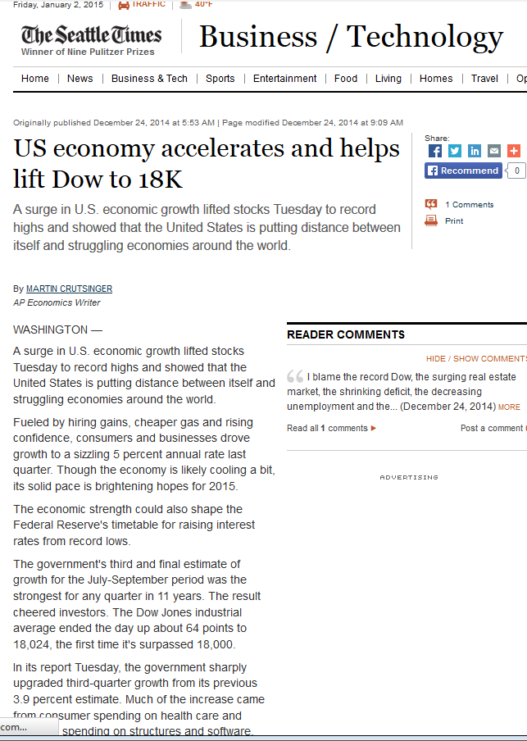
Using the Regression Line to Make Predictions
As we see from the article, there are a lot of measures used to describe our economy. Decisions (by the Federal Reserve for example) will be made based on those numbers.
However, how do we know that the economy will continue to improve?

Slide 5
Using the Regression Line to Make Predictions
Regression Line
As we saw from our scatter plot, consumer confidence decreases as the unemployment rate decreases. Since we don’t know the consumer confidence index for 2014, we can predict its value using the graph.
We can use a model to make predictions based on the previous data. The model that we will be using is a linear model called the regression line or line of best fit. When two variables are linearly related, we can use a line to describe their relationship. We can also use the equation of the line to predict the value of the x-variable based on the value of the x-variable.
The regression line (or line of best fit) is a line drawn in the scatter plot in which the distances from the points to the line are as short as possible. We can draw a line in the graph, as shown below, to approximate the regression.

Slide 6
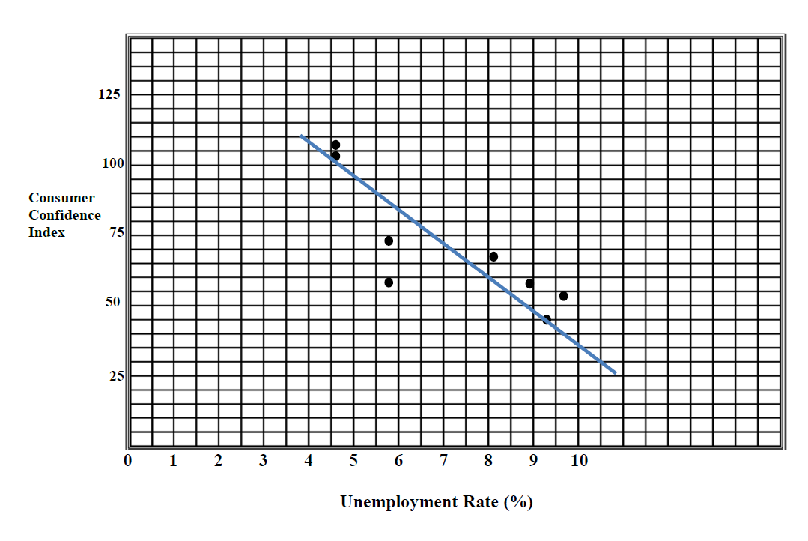
Using the Regression Line to Make Predictions

Slide 7
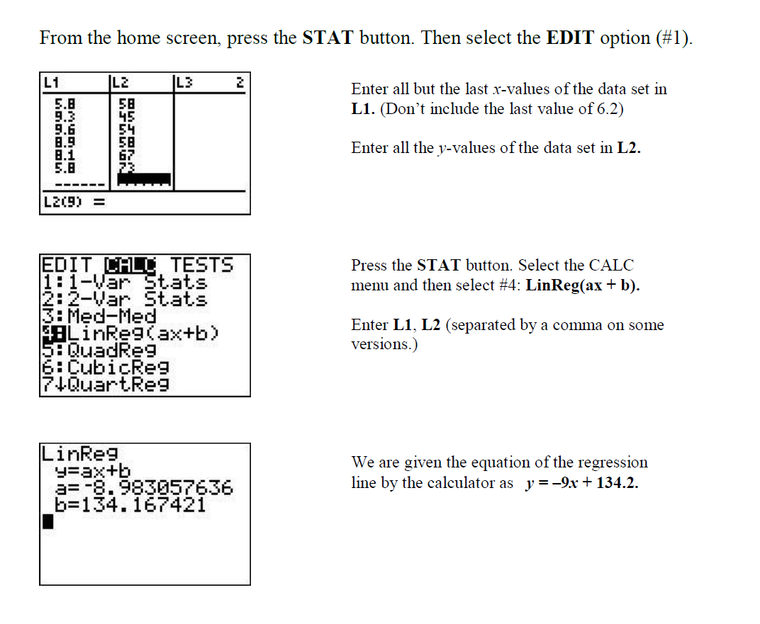

Slide 8
Using the Regression Line to Make Predictions
What is the context of the slope in this example?
What is the context of the y-intercept in this example?
Now that we have an equation for our line of regression, we can predict the average consumer confidence level for 2014. Substitute the x-value of 6.2 into the equation and solve for y.
y = –9x + 134.2
y = –9(6.2) + 134.2
y = –55.8 + 134.2
y = 78.4
So, the average consumer confidence level for 2014 was 78.4 points.

Slide 9
Using the Regression Line to Make Predictions
Conclusion
Understanding data is a crucial segment of news literacy. Not only do we need to understand the data that is presented in the news, but we are required to analyze it as well. We can make predictions when there is a relationship in the data. If we model that relationship, such as with a regression line, we can predict where other variables will lie within our data. Predictions are often used to shape decisions. For example, if the temperature is predicted to be cold tomorrow, then we decide to wear heavier clothing.
We rely on the news medium to report on decisions that impact our lives. For example, when interest rates are lowered, we know that we can borrow more money (at lower rates) in order to spend more. When interest rates are raised, then it will cost more to purchase goods (such as a house or car) on credit.
The decision to raise or lower interest rates is based on data from economic indicators such as the unemployment rate and consumer confidence index. Representatives from the Federal Reserve System make predictions based on this data.

Slide 10
Principles of News Literacy
3. When the process of gathering and reporting is transparent, news and information are more meaningful, trusted and credible.
Journalists must present information free of bias and agendas. They should clearly identify issues or limitations on that information, including reporting that the information might be incomplete or from questionable sources. Journalistic independence is essential to this process.
Readers and viewers must understand a source’s agendas, motivations and backgrounds so they can make full use of that information, assessing what is true. They need to insist on independent journalists, professionals free of outside obligation and limitation, so they can trust the information they receive. They need to hold media accountable for the quality of information delivered. If members of the public are news sources, they must identify their biases and be transparent in their actions.

Slide 11
Principles of News Literacy
4. Effective communication of news and information requires synthesis of multiple sources into meaningful context and comprehension of its impact
Journalists must make sense of information, using the most credible and reliable resources, so audiences can make meaningful use of it, in context, with a minimum need for clarification. In short, journalists must get it right. And it must be presented in a relevant, engaging manner without sensationalism, speculation and bias.
Citizens must take responsibility to make every effort to understand information received, including asking questions and pursuing their own versions of it. They must demand credible and reliable information sources, not infotainment based on information that is not right. And they must be taught the importance of seeking information of consequence.

Slide 12
Principles of News Literacy
5. Information requires verification to be effective
Journalists must find the best resources and substantiate what they say. They should present information in coherent ways as well as keep it clear, meaningful and relevant. The purpose of news is not diversion but the sharing of usable and reliable information in an engaging and relevant way. Journalists must question sources without advocacy or disengagement. Journalists’ roles can be called “engaged independence.”
Individuals must expect that the information they receive is accurate, thorough and reliably sourced and that the media delivering this information is responsible and credible. Communities must not accept information without critical thought and analysis, including comparison and evaluation. In evaluating such information, they should be involved, skeptical and challenging, in what they act on.

