Slide 1
Verifying Probability in the News

Slide 2



Verifying Probability in the News
News organizations often report on people living past the age of 100. (They also report on advice we can use to live past 100 years.) How unlikely is it to live past 100 years?

Slide 3
Verifying Probability in the News
1) What are the odds of living past 100 years in the U.S.?
(According to the U.S. Census, 53,364 people lived past 100 years in 2010, when the population was 308,700,000)
2) Do you think it’s improbable to live past 100 years?
3) Women make up 82.8% of people living past 100 years and men make up just 17.2% of individuals living past 100 years.
What is the probability of a woman living past 100 years?
What is the probability of a man living past 100 years?
4) According to a 2012 United Kingdom Daily Mail article, 640 Britons have reached 105 years old. The population was estimated at 63,700,000 people. What is the probability of a resident of the country reaching his or her 105th birthday?

Slide 4

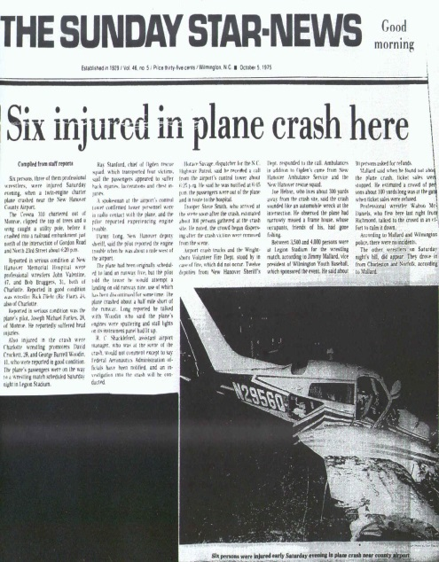

Verifying Probability in the News
Headlines of plane crashes immediately grab the attention of the public due to many factors including our fears of flying, the rarity of aviation disasters, and the unlikeliness of surviving a crash.

Slide 5
Verifying Probability in the News
From 2011– 2013, there was an average of 1,462 private and commercial airline accidents. There was an average of 454 deaths in those accidents, according to the United States Department of Transportation and National Transportation Safety Board (NTSB).
1) If there are approximately 27,000 departures per day in the U.S, what is the probability that one of those flights will be involved in an accident?
2) If there was an average of 813,353,472 airline passengers in the U.S., what is the probability that someone will be involved in a fatal crash?
3) What are your thoughts on the above probabilities?
Most airplane accidents that occur are small private (personal) planes and instructional planes. Here are the figures for only commercial and commuter passenger airlines:
Average number of accidents: 75
Average number of flights: 9,662,667
Average number of fatalities: 31
Average number of passengers: 734,000,000
4) What are the probabilities of being involved in an accident? In a fatality?
5) Do these new probabilities change your perception of the risks of air travel? Explain your answer.

Slide 6


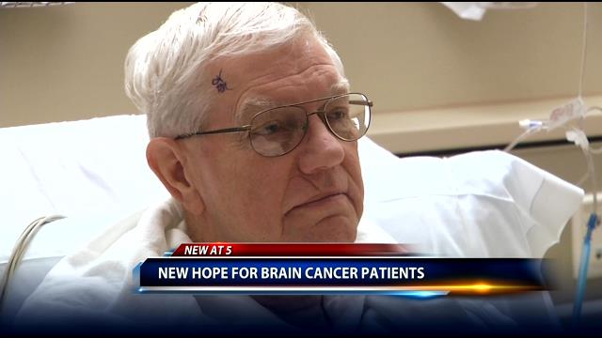
Verifying Probability in the News
News reports about people struggling to beat the odds can also be heartwarming. For example, stories about patients given only months to live who end up surviving their illnesses or diseases to go on living happy and productive lives are newsworthy because the outcome was unexpected. Some afflictions, such as cancer, have lower survival rates than other illnesses (such as pneumonia, for example) so the probability of survival is lower. Also, the more a disease or illness progresses, the lower the chances of surviving.

Slide 7
Verifying Probability in the News
Let’s take the example of a brain tumor, which generates headlines about survivors due to its difficulty to overcome. There are approximately 343,000 patients living with brain or spinal cord tumors in the U.S. Every year, about 14,000 people die from the cancer.
1) What is the probability of surviving a brain or spinal cord tumor? Use the complement of an event to calculate your answer.
2) The probability of surviving a brain tumor decreases if the cancer is not cured. The probability of surviving a brain tumor for 5 years is about 1/3. How many people living with the disease will survive after five years?
3) If there are 68,000 new cases of brain tumors each year, what is the probability that someone will become afflicted in 2015? (2015 population estimate: 321 million)

