Slide 1
Eight News Values
For measuring newsworthiness

Slide 2
IMPACT
What is the definition?

Slide 3
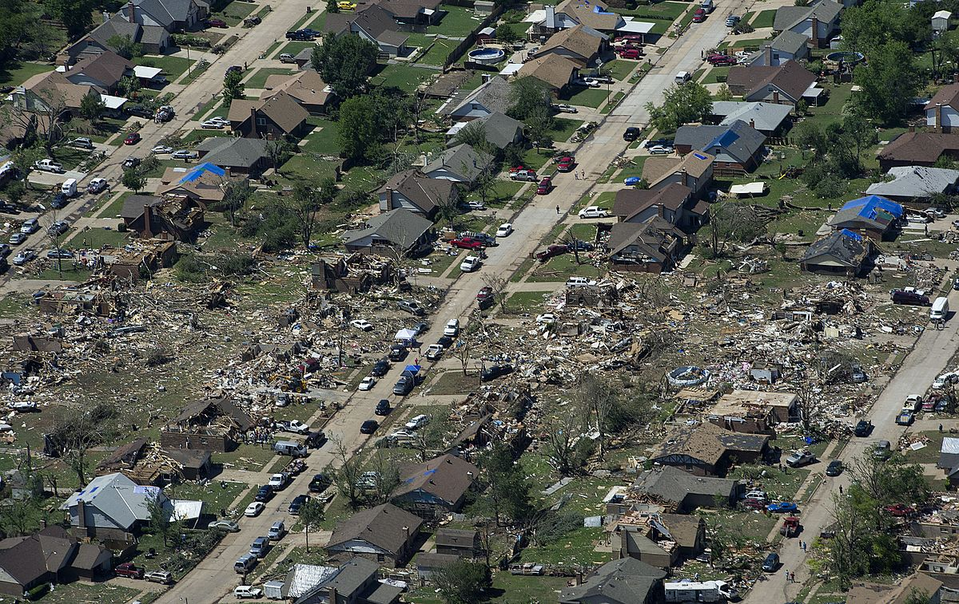
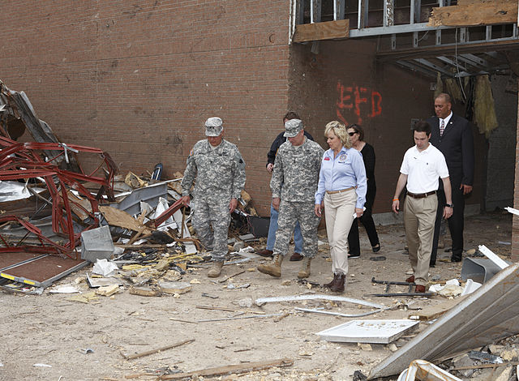
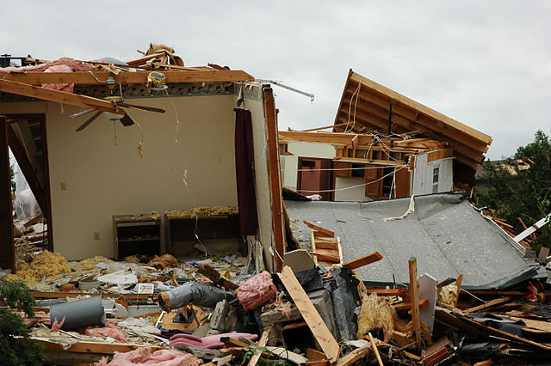
IMPACT
How many people are affected? How seriously are they affected?
Notes:
This is where we get the term “hard-hitting” journalism. While an event may be considered newsworthy because of its appeal or its novelty, the most important news stories have IMPACT.

Slide 4
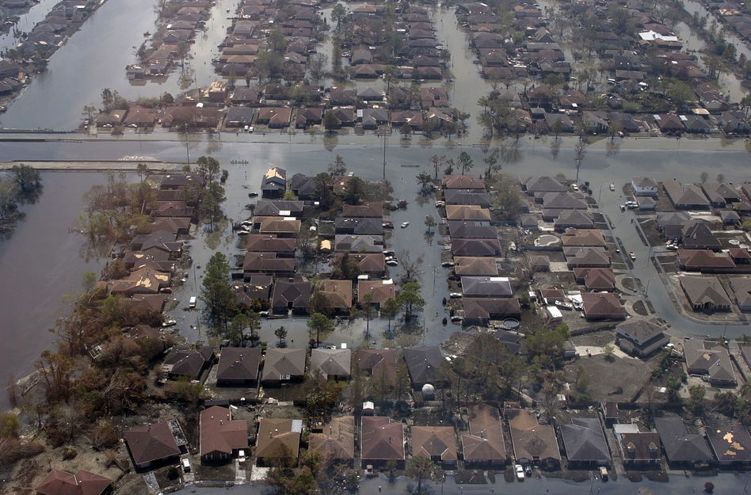
IMPACT EXAMPLES
Natural disasters that are or compare to unprecedented events
Passage of legislation on a state or national level
An election
Notes:
Other examples of newsworthy events with significant impact include: Natural disasters such as Hurricane Katrina that are or compare to unprecedented events; passage of legislation on a state or national level or an election.

Slide 5
WEIGHT
What is the definition?

Slide 6
WEIGHT
Similar to impact BUT…
WEIGHT of a story includes how many & how seriously, but can also be measured by depth of pain, shock or how “out of character” or “unexpected” something might be
How seriously?
How many?
WEIGHT
Out of character Unexpected
Shock
Depth of pain
IMPACT
vs.
Notes:
Weight is very similar to impact… in fact, sometimes it is hard to tell the two apart without actually using the word “heaviness.” The weight of a story also includes how many and how seriously, but can also be measured by the depth of pain, shock or how “out of character” or “unexpected” something might be.

Slide 7
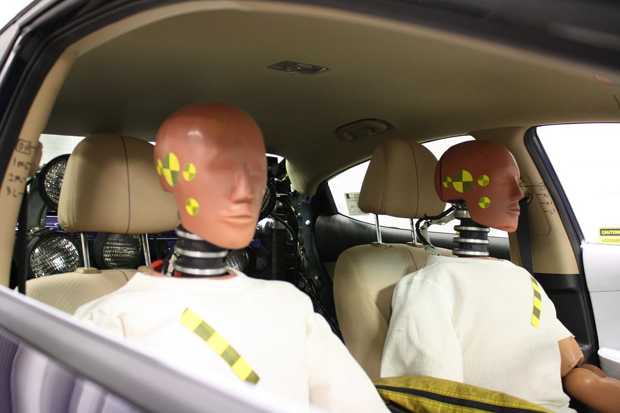
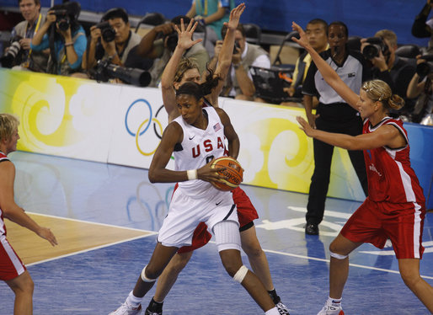
WEIGHT EXAMPLES
Accidental death vs. injury
National sporting event vs. local sporting event
Notes:
The death of four young people in an accident bears more weight than the injury of four young people.

Slide 8
TIMELINESS
What is the definition?

Slide 9
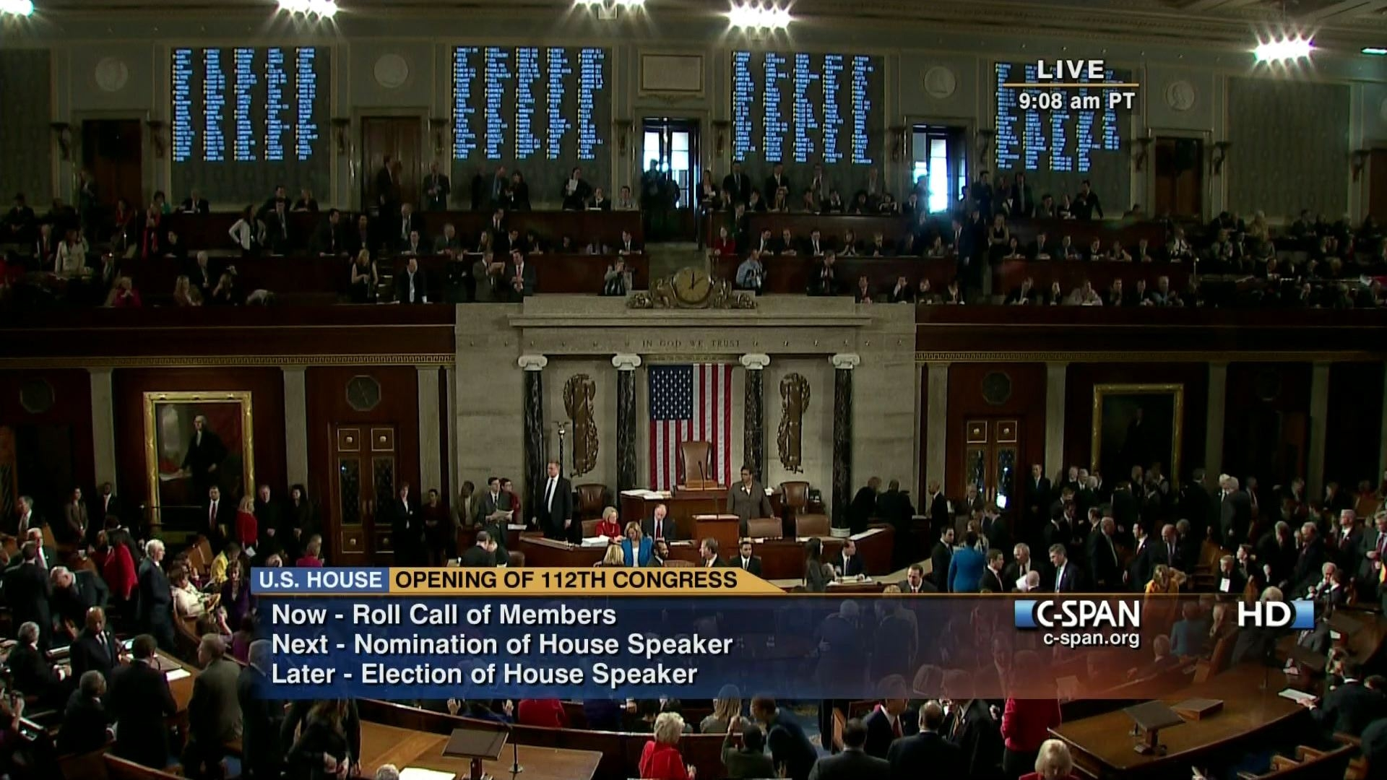
TIMELINESS
What is new?
The quality of timeliness is that the story provides new, updated relevant information
It is not OLD news

Slide 10
TIMELINESS EXAMPLES
What happened today trumps last week’s news
Updates on conditions, charges, investigations add timeliness to older news

Slide 11
PROXIMITY
What is the definition?
Notes:
Ask students to define impact.

Slide 12
PROXIMITY
Nearness to the audience
(both emotionally and physically)
People want to make personal connections
“hits close to home”
sometimes the big stories have to be funneled
and the scope narrowed to explain
the importance on a “proximous” level

Slide 13
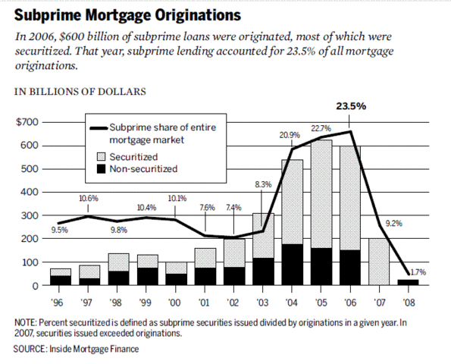
PROXIMITY EXAMPLES
National mortgage crises covered in reference to local people losing their homes
Health epidemics/diseases and how parents can protect their children

Slide 14
PROMINENCE
What is the definition?
Notes:
Ask students to define impact.

Slide 15
PROMINENCE
The bigger you are, the bigger the target!
People are naturally curious about people who are famous or in positions of power
But they also have the power to make an event that might not be big news, a big deal!

Slide 16
PROMINENCE EXAMPLES
Britney Spears shaves her head (hundreds of thousands of people do this every day…) Taylor Swift goes to a small-town high school prom with a fan (suddenly the prom is newsworthy)

Slide 17
CONFLICT
What is the definition?
Notes:
Ask students to define impact.

Slide 18
CONFLICT
Newsworthy because two or more people, entities, groups or teams are opposing one another
People want to witness or know the outcome of the conflict
THERE AREN’T TWO SIDES TO EVERY CONFLICT
Sometimes, the conflict is within and that makes the story newsworthy; i.e. overcoming obstacles or personal struggles

Slide 19
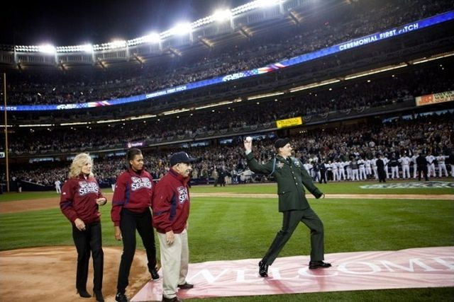
CONFLICT EXAMPLES
Presidential Debates
The World Series
Steve Jobs Biography

Slide 20
NOVELTY
What is the definition?
Notes:
Ask students to define impact.

Slide 21
NOVELTY
Means the story is intriguing or has an interesting spin to it, not something you hear of everyday
IN REALITY: It is hard to verify and play an editorial role for this type of story

Slide 22
NOVELTY EXAMPLES
Notes:
A U.S. petty officer levels the surface for a gazebo to expand a school during a Continuing Promise 2008 humanitarian assistance project; news crew filming the excavation and relocation of turtles at a beach

Slide 23
USEFULNESS
What is the definition?
Notes:
Ask students to define impact.

Slide 24
USEFULNESS or STEWARDSHIP
Information that the public needs to navigate the world
SAFELY
EFFICENTLY
ECONOMICALLY

Slide 25
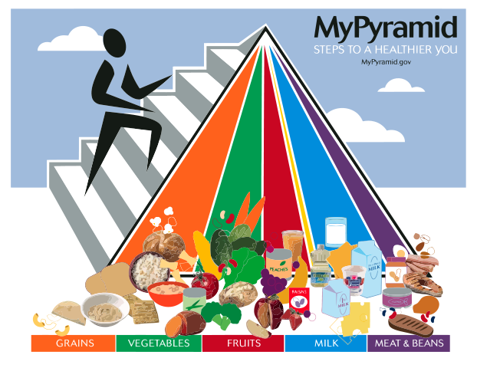
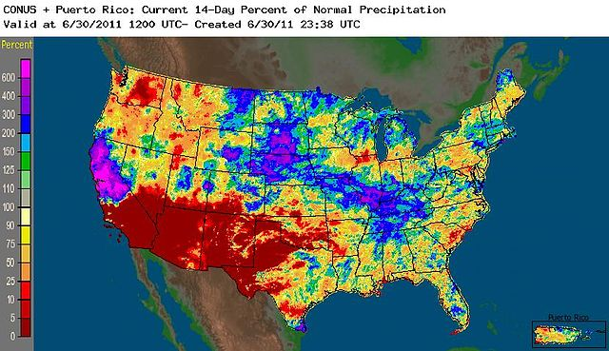
USEFULNESS or STEWARDSHIP EXAMPLES
weather reports
health information
investigative pieces
stories about good deeds

Slide 26
Eight News Values
For measuring newsworthiness

