Slide 1
Editing and Style
Just because you wrote it doesn’t mean you’re finished!

Slide 2
COPY EDITING
Copy editing is the QUALITY CONTROL function for a publication.

Slide 3
GOALS OF COPY EDITING:
Clarity - copy editors must make sure the story is clear and makes sense
Correctness - copy editors have to double check the facts and the accuracy
Conciseness - copy editors make sure the story is told in the most efficient way possible
Consistency - copy editors make sure the rules, style and other elements of the story are consistent and remain the same throughout.
Coherency - copy editors make sure that the story is well-put together and easily readable.

Slide 4
HOW DOES A COPY EDITOR ACHIEVE THOSE THINGS?
Correcting writing, usage and fact errors
Rewriting when a sentence is unclear or wordy

Slide 5
WHAT IS THE PROCESS?
•Copy editors use a variety of STANDARD PROOFREADING MARKS to indicate errors.

Slide 6
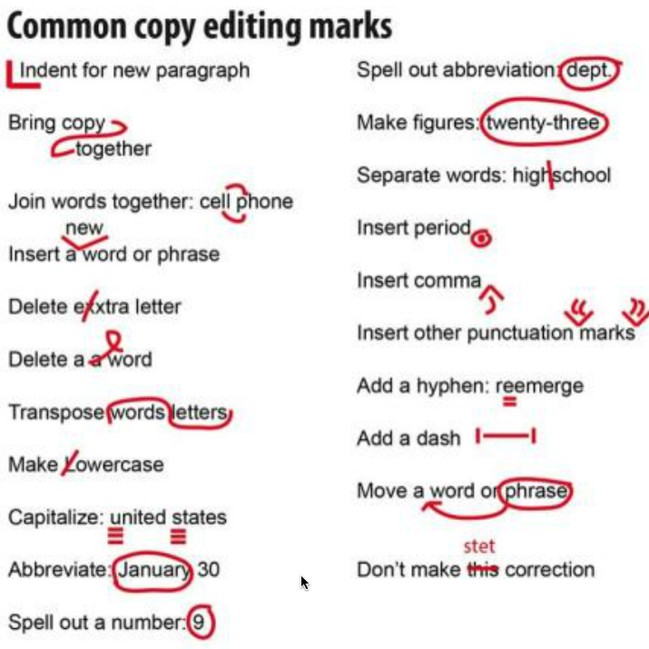
Common
Copy
Editing
Marks

Slide 7
WHAT DID YOU MEAN BY “STYLE” OF WRITING?
Style refers to the CONVENTIONS of writing
  Capitalization
  Hyphenation
  Accepted spelling
    Theater or theatre
    Lead or lede

Slide 8
WHERE DO THE CONVENTIONS COME FROM?
THE ASSOCIATED PRESS STYLEBOOK
  Set of guidelines for journalists published annually by the Associated Press
  Designed to help journalists communicate quickly and clearly

Slide 9
WHY IS THE STYLE BOOK NEEDED?
Readers appreciate consistency
    If the word “presidency” is capitalized in one sentence and not in another, it makes the publication look sloppy.
Journalists work fast and there is no time to make up rules on deadline.

Slide 10
SOME AP STYLE GUIDELINES:
Titles - only formal titles are capitalized and only when in front of a name:
    The president came to visit
    President Smith was here to visit
Dates/Times - abbreviate the names of months when you use the exact date; MONTHS WITH FIVE OR FEWER LETTERS ARE NEVER ABBREVIATED.
    The word “today” is ok, but DO NOT USE THE WORDS “YESTERDAY” OR “TOMORROW.”

Slide 11
MORE AP STYLE...
Acronyms - Do not use an acronym the first time you mention the organization or in the first reference.
  The Mexico High School administrators… But MHS officials aren’t sure…
Numerals - one through nine are spelled out; use figures for 10 and above.
  EXCEPTIONS TO THIS RULE:
    Ages are ALWAYS figures
    For depth, height, length and width always use figures
    Money and percentages are always figures
The Oxford comma - that’s the comma before the “and” in a series. AP style says DON’T USE IT unless omitting it makes the sentence unclear.

Slide 12
FACT CHECKING:
Copy editors serve as fact checkers. THEY ENSURE ACCURACY.
  Make sure all of the information passes the “who said this” and “how do they know it” test
If you need to fact check:
  Use the Internet, but only reliable sources on the Internet
  If something seems like a coincidence, like James Jones lives on Jones St., or something just seems off… LOOK IT UP!

Slide 13
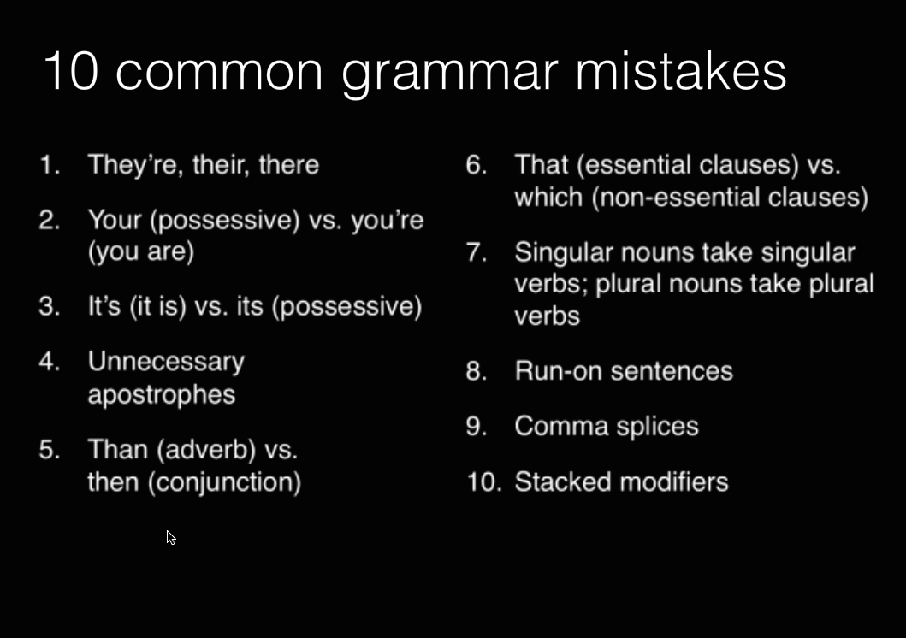
FACT CHECKING GRAMMAR:

Slide 14
POINTERS FOR WRITING:
If you need a breath when reading a sentence out loud, it needs to be two sentences.
Don’t separate two independent clauses with a comma. Use a period or semicolon instead.
Don’t stack too many adjectives in front of a noun. It makes the sentence difficult to understand.

Slide 15
Editing and Style
Just because you wrote it doesn’t mean you’re finished!

