Slide 1
PHOTOGRAPHY 101
The Basics Will Take You Far...

Slide 2
HOW TO TAKE A GOOD PICTURE:
Composition - where everything is in the picture
  Rule of Thirds
    Diagram your screen so that it looks like a tic-tac toe board
    To compose a strong photo, place the eyes, or the main object in the photo in the far right column or the far left column… NOT in the middle

Slide 3
THE RULE OF THIRDS:
GOOD SPACE
VERTICALLY
GOOD SPACE
HORIZONTALLY
GOOD SPACE
VERTICALLY
GOOD SPACE
HORIZONTALLY

Slide 4
WHEN USING THE RULE OF THIRDS:
VERTICALLY (up and down)
  Place objects or people in far right or far left
  If shooting a portrait, keep the eyes near the intersections of the lines
HORIZONTALLY(left to right)
  Horizon line should NEVER be in the middle of the picture either more land/less sky or more sky/less land

Slide 5
COMPOSITION AND POINT OF VIEW:
Remember you are telling a story and just like a written story you need a good angle
Often, changing the angle can add an interesting slant to the photo and engage the viewer even more
Use the rule of thirds to help lead your viewers into the picture across the picture and out of the frame
The rule of thirds can be applied during cropping if it was not accomplished during the actual photo

Slide 6
COMPOSITION AND LIGHTING:
Lighting helps you set the tone for the picture
  The tone will help you tell the reader how to feel
Low angle light that evenly illuminates the subject is essential to a great photo
Shooting outside can be tricky unless you are experienced so follow some basic rules
  It’s best to shoot in the shade if you are in direct sunlight
  Try taking the subject inside if at all possible and shoot near a window, but avoid direct sunlight

Slide 7
SHOOTING ON THE FLY:
The best camera to use is the one you have with you…
  Shooting with your cell phone
    Don’t count on it before you have practiced with it
    Know the camera’s limitations
    The major drawback is the inability to switch lenses
      They do make lenses for cell phones - find them easiest on Amazon.com and they are phone specific
    Phone cameras will do in a pinch as along as you understand how to properly use your phone camera to get the best photo possible

Slide 8
SHOOTING WITH A DSLR:
DSLR = Digital Single Lens Reflex camera
  Shooting with DSLR is ideal BUT you have to understand your DSLR
  Most DSLR’s have model and maker specific instructions
  One of the most important things to understand is how to control exposure (the amount of light that is allowed into the camera for whatever amount of time)

Slide 9
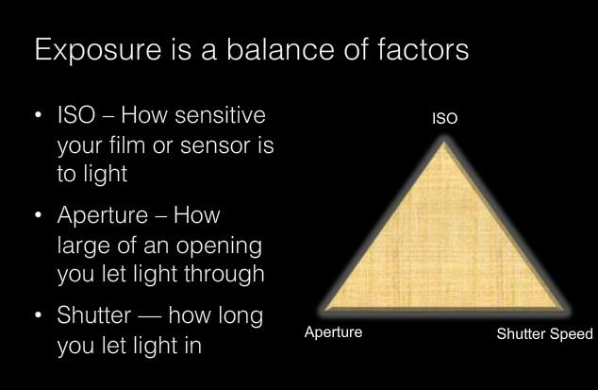
THE EXPOSURE TRIANGLE

Slide 10
THE ISO:
The level of camera’s sensitivity to available light
The higher the ISO, the less light you need
The higher the ISO, the noisier the image

Slide 11
THE APERTURE or THE F-STOP:
The size of the opening in the lens that lets light through
The bigger the number, the smaller the opening
The larger the f-stop, the greater your depth of field
  Use depth of field to control how much of your image is in focus

Slide 12
SHUTTER SPEED:
The length of time that the film or sensor is exposed to light
A fast shutter speed freezes movement
A slow shutter speed blurs movement

Slide 13
PHOTOGRAPHY 101
The Basics Will Take You Far...

