Slide 1
ANTS

Slide 2


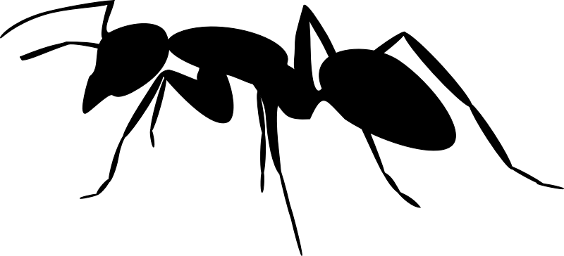
WRITE A QUESTION

Slide 3
TURN
TALK
AND

Slide 4


Slide 5


Slide 7
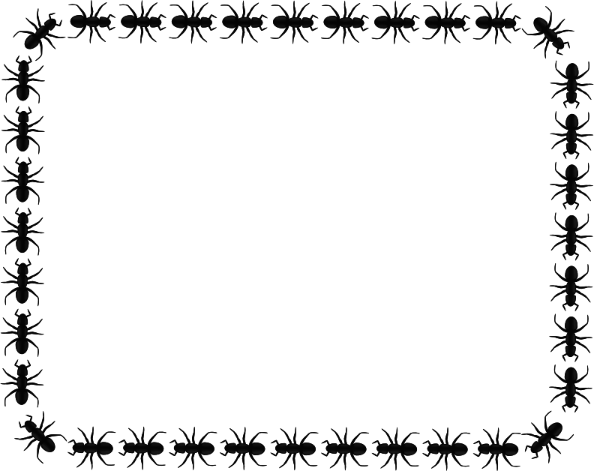
WRITE DOWN YOUR GUESS
IF YOU TOOK ALL THE ANTS IN THE WORLD AND COMPARED THEM TO ALL THE HUMANS, WHICH WOULD WEIGH MORE?

Slide 8
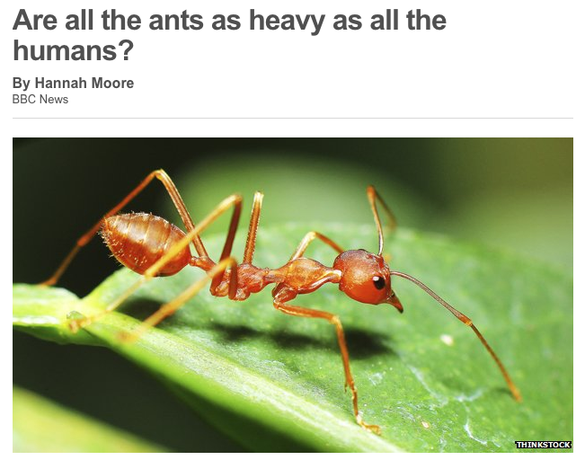

Slide 9
How Many Ants are there?
Part 1: The BBC article writes “British entomologist C.B Williams calculated that the number of insects alive on earth at a given moment was one million trillion. Write this number in scientific notation.
Part 2: If 1% of the insect population consists of ants, how many ants would there be? Show your work.
Part 3: In the The BBC Four documentary, one claim for the number of ants is 100 trillion. Write this number in scientific notation.
Part 4: So, how many ants do you think there are? Give a reasonable range below.
High Estimate: Low Estimate:

Slide 10
How much do the ants weigh?
Read the three quotes from the BBC article below and address the synthesis question at the bottom of the page.
QUOTE 1:
Individual workers weigh on average between 1 to 5 mg, according to the species.
QUOTE 2:
The common ants which live in British gardens weigh about 1mg or 2mg.
QUOTE 3:
It's probable their weights vary greatly - though most experts seem to agree the average weight of an ant is less than 10mg.
Synthesis Question:
Use all of the information given so far to construct a reasonable estimate for the total weight of all ants on Earth. Include a high number, low number and best estimate.

Slide 11
How much do all the humans weigh?
Average Human Adult = 62 kilograms. Write this number in scientific notation.

